Slide 1
Announcements
Start project 2 coding ASAP!
If you haven’t make sure you’ve watched these videos on getting started
Phase 1 almost over (early deadline is today)
Read the clarifications here: https://piazza.com/class/j9j0udrxjjp758?cid=1616
Update your IntelliJ plugin to v1.0.21!

Slide 2
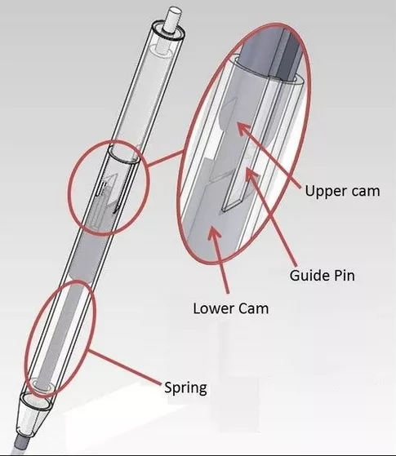

CS61B, Spring 2018
Lecture 16: Programming Efficiently
Programming Efficiently, APIs
ADT Implementations
Views

Slide 3
61B: Writing Efficient Programs
“An engineer will do for a dime what any fool will do for a dollar”
-- Paul Hilfinger
Efficiency comes in two flavors:
Programming cost.
How long does it take to develop your programs?
How easy is it to read, modify, and maintain your code?
More important than you might think!
Majority of cost is in maintenance, not development!
Execution cost (starting next week).
How much time does your program take to execute?
How much memory does your program require?
Mostly tweaks and improvements, though some bug fixes, too.

Slide 4
Keeping Programming Costs Low
Some Java features discussed in 61B:
Packages.
Good: Way of organizing a large project.
Bad: Import * is dangerous!
Static type checking.
Good: Promotes code clarity, very explicit, can prevent some errors.
Bad: Very verbose
Inheritance.
Good: Can reuse code.
Bad: Can become confusing!

Slide 5
Keeping Programming Costs Low (Java Features)
Some Java features discussed in 61B:
Packages.
Good: Keep code organized (in folders). Canonical names for classes and other things.
Bad: More work to compile and run.
Static type checking.
Good: Speeds up runtime (no need to runtime type check). Catch errors early (before anybody runs the code).
Bad: More verbose code.
Inheritance (implementation and interface inheritance).
Good: Interface inheritance allows subtype polymorphism. Implementation inheritance allows code reuse.
Bad: Have to implement all features of an interface (can be many). Makes code harder to read/understand. More that we’ll discuss.

Slide 6
Keeping Programming Costs Low (Programming Practices)
Modularity: How can I break my problem down into easily understood subproblems?
Invariants: What properties must my algorithm or data structure maintain?
Many programmers only consider invariants implicitly. Some write them out.
Testing: Create automated code verification tools to bolster (but not prove) correctness.
A general framework for proving that code is correct is impossible. It’s not even possible to prove that a piece of code avoids going into an infinite loop (see the halting problem if you’re curious).

Slide 7
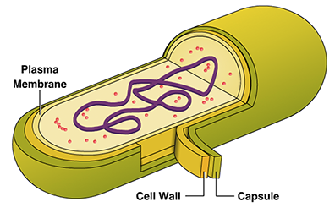
Modules and Encapsulation (this slide, a blast from the past)
Module: A set of methods that work together as a whole to perform some
task or set of related tasks.
A module is said to be encapsulated if its implementation is completely hidden, and it can be accessed only through a documented interface.
Example: An Abstract Data Type describes an encapsulated data structure.
Recall, from week 2:
addLast()
size
sentFront
sentBack
getBack()
2
removeLast()
size()
??
3
9
??
prev
item
next

Slide 8
ADTs and APIs
The API (Application Programming Interface) of an ADT is the list of constructors and methods, including an informal description of the effect of each.
Not a precisely defined term. Some real world definitions of API are broader than ours.
API consists of syntactic and semantic specification.
Compiler verifies that syntax is met.
Tests help verify that semantics are correct.
Semantic specification usually written out in English (possibly including usage examples). Mathematically precise formal specifications are somewhat possible but not widespread.

Slide 9
Example of a Semantic Specification
A semantic specification of project 2 from two years ago
Link: https://docs.google.com/document/d/17PUw2EffgyU5_zQHZ8GV52EhS3NPwUyghFfX6EmJiS4/edit
This idea of hiding details from yourself or other programmers is critically important!
This skill is a major divide between struggling and thriving 61B students.
Struggling students try to fit everything in their head at once.

Slide 10
Designing an API
One of the hardest parts about writing a program is deciding on the API.
Project 2 will give you your only chance to do this in 61B.
You’ll find that it is a challenging task!
In the real world, API decisions are truly momentous.
If you add a public method or variable, you are saying that it will be available… forever!
Google and Oracle (owners of Java) lawsuit:
Google created their own implementation of some of Java’s API.
Oracle claimed this was copyright infringement!
Google responded that their implementation was “fair use”.
Lawsuit started in 2010, recently finished (Jury sided with Google)

Slide 11
Designing an API
API design and data structure selection can be an iterative process.
Nice to get it right the first time.
But if you don’t, it’s often worth the trouble to refactor your code.
The majority of your effort will be spent on the design!
Word of warning: Map<String, Map<Integer, Double>> someMap;
Complex data type specifications like this can be a sign that you need to hide more from the class using the someMap variable.
Example: Map<String, TimeSeries<Double>> someMap;
{FB: 2012: 26, 2013: 55, 2014: 78, 2015: 104,
AMZN: 1997: 4.5, 1998: 53, 1999: 106, 2000: 15, 2001: 10,
NFLX: 2003: 0.77, 2004: 1.65, 2005: 3.96, 2006: 3.74,
GOOGL: 2004: 96 2005: 233, 2006: 230, 2007: 300, 2008: 295}
{FB: TimeSeries@f83f9182
AMZN: TimeSeries@087d7f33
NFLX: TimeSeries@7caaad29,
GOOGL: TimeSeries@99ffe71c}

Slide 12
API Design Issues. See CS 169 for more.
Potential pitfalls.
Too hard (or impossible) to implement.
Too hard to use, e.g. arguably JavaFX.
Too general, e.g. the God object. Does too much on its own.
Too specific, e.g. many libraries for making graphical plots (matplotlib).
Too narrow, e.g. our early SList had no get(i) method.
Too wide, e.g. the get(i) method in Deque.
Too wide, e.g. the java.util.Stack class (more soon).
Helpful motto: “Provide to clients the methods they need and no other.”
- Joe Armstrong

Slide 13
ADT Implementations

Slide 14
ADT Implementation
Recall that ADTs are implemented using data structures (think List vs. Array).
Often implemented using existing data structures.
Examples:
LinkedListDeque from project 1 >>>
In project 2, you are implementing a Grid ADT with existing data structures.
Use vs. Implementation
LinkedListDeque
implements
Deque ADT
uses
LinkedList
implements
List
ADT
Notes:
ADTs are implemented using data structures
Arrays (data structure) can be used to implement list types
Because of this we often use existing data structures that we know about to (arrays, linked lists, trees, etc)
<pause> Examples you’ve already seen
LinkedListDeque from proj1
Proj2 youre going to implement a Grid ADT maybe using some data structures that already exist in the Java standard library
Throughout this section, think about use vs implementation
ADTs discuss how the data should be used
Datastructure discuss how the use is implemented
Let’s see use right now why this distinction is useful

Slide 15
Special Case ADTs
Sometimes, ADTs are special cases of other ADTs. Three common special cases for Lists:
Queue (also known as a line in America): Supports enqueue and dequeue.
enqueue: puts an item at end of queue
dequeue: removes and returns item at front of queue.
Also called a FIFO (first-in, first-out) List.
Stack: Support push and pop.
push: puts things on ‘top’ of stack
pop: takes things off the top.
Also called a LIFO (last-in, first-out) List.
Deque: Support addFront, addBack, getFront, getBack.
your old friend from project 1a
Notes:
Because ADTs discuss use, we can note that some ADTs are special cases of others
Queue
Because this list restricts access to only inserting at the end and removing from the front, we call this a FIFO list
Questions?
Cool let’s talk about implementation

Slide 16
Implementing Special Cases: Extension, Delegation, Adaptation
Suppose we have a List of some type, say a LinkedList. How do we get a Stack?
Notes:
So that’s the use, let’s talk about the implementation
How would you implement the stack? Take a minute

Slide 17
Implementing Special Cases: Extension, Delegation, Adaptation
Two natural approaches:
Extension:
Delegation:
public class ExtensionStack<Item> extends LinkedList<Item> {
public void push(Item x) {
add(x);
}
}
Careful about has-a vs. is-a relationship!
More soon.
public class DelegationStack<Item> {
private LinkedList<Item> L = new LinkedList<Item>();
public void push(Item x) {
L.add(x);
}
}
Notes:
Two common design patterns in OOP are extension and delegation.
Extension
Implement stack functionality by extending from the appropriate super class
Use the super class’s method to implement the ADT’s functionality.
We implement push using add taken from Linked List
Delegation
“A king, realizing his incompetence, can either delegate or abdicate his duties.”
Create a linked list as an instance variable then use this instance variable’s functionality to implemet the ADT
Here we use L’s add method to implement push

Slide 18
Implementing Special Cases: Extension, Delegation, Adaptation
Another (more exotic) approach:
Adaptation:
public class StackAdapter<Item> {
private List L;
public StackAdapter(List<Item> worker) {
L = worker;
}
public void push(Item x) {
L.add(x);
}
}
Notes:
A third more fancy design pattern is adaptation
Adaptation takes another ADT and morphs it into the ADT that we want
In this example, we take a List ADT and morph into the Stack ADT that we want.
Because we’re taking in a list via the constructor, we can use that list’s add to implement push
The key difference here b/w this and delegation…
We can accept ANY implementation of a List
The worker can be any class that implements the List interface
We can adapt a wide variety of List implementations into the Stack that we want.

Slide 19
Designing ADTs

Slide 20
Is-A vs. Has-A
Is-A:
Examples:
A Square is-a Rectangle.
An ArrayList is-a List.
In linguistics, known as hyponymy. ArrayList is a hyponym of List.
Has-A:
Examples:
Animals have-a Leg.
GuitarString has-a ArrayRingBuffer.
In linguistics, known as holonymy. Animals is a holonym of Leg.
Inheritance relationships should ALWAYS be is-a relationships. Can be subtle.

Slide 21

The java.util.Stack: A Prime Example in Bad Design
Created using extension instead of delegation.
Authors asserted that a Stack IS-A Vector.
Resulting API:
Is complex (too wide).
Is counterintuitive (iterators work backwards).
http://goo.gl/rU064i
Collection
List
https://www.amazon.com/dp/B001DZTJRQ
AbstractList
Vector
Stack
“You wanted a banana but what you got was a gorilla holding the banana and the entire jungle.”
- Joe Armstrong (on OOP)
Notes:
Wenger 16999 Swiss Army Knife includes 87 implements (list price = $1400)

Slide 22
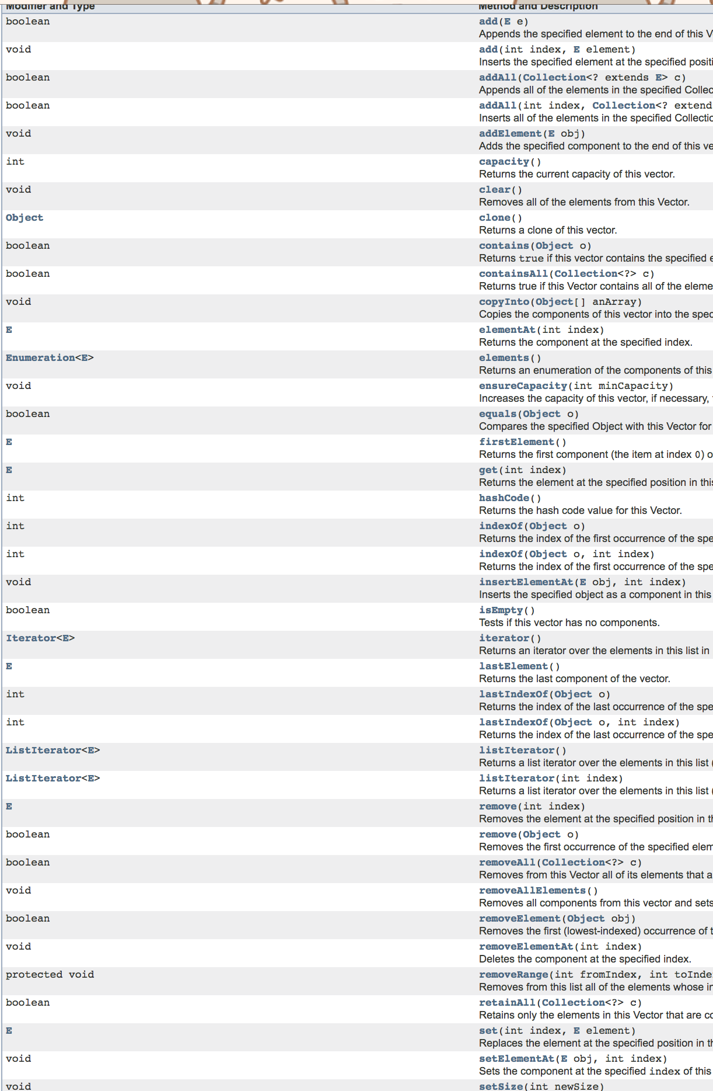
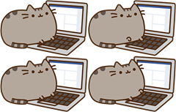
The java.util.Stack: A Prime Example in Bad Design
Created using extension instead of delegation.
Authors asserted that a Stack IS-A Vector.
Resulting API:
Is complex (too wide).
Is counterintuitive (iterators work backwards).
http://goo.gl/rU064i
Collection
List
AbstractList
Vector
Stack
“You wanted a banana but what you got was a gorilla holding the banana and the entire jungle.”
- Joe Armstrong (on OOP)

Slide 23
An Even More Subtle Inheritance Pitfall
Classic example: A Square is-a Rectangle.
Deep arguments about program and programming language design result. See the circle-ellipse problem for more.
/** Sets the width. */ public void setWidth(int w) { width = w; } /** Sets the height. */ public void setHeight(int h) { height = h; }
public class Rectangle { private int width; private int height; public Rectangle(int w, int h) { width = w; height = h; }
public class Square extends Rectangle { ...

Slide 24
Implementation Inheritance Breaks Encapsulation
What would vd.barkMany(3) output?
c. Something else.
Gets caught in an infinite loop!
(assuming vd is a Verbose Dog)
public void bark() {
barkMany(1);
}
public void barkMany(int N) {
for (int i = 0; i < N; i += 1) {
System.out.println("bark");
}
}
bark()
Dog
@Override
public void barkMany(int N) {
System.out.println("As a dog, I say: ");
for (int i = 0; i < N; i += 1) {
bark();
}
}
barkMany(int N)
bark()
VerboseDog
calls inherited bark method
barkMany(int N)

Slide 25
Delegation vs. Extension
As Josh Bloch puts it in Effective Java:
It is safe to use inheritance within a package, where the subclass and the superclass are under the control of the same programmers.
It is safe to extend classes specifically designed and documented for extension.
Inheriting from ordinary concrete classes across package boundaries is dangerous.
When in doubt: Use delegation and write simple forwarding methods for each method.

Slide 26
Views

Slide 27
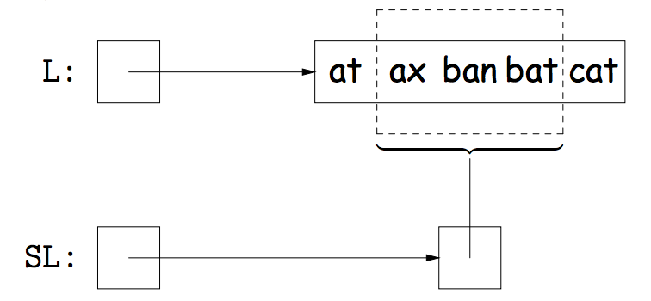
Views into Lists
An alternative representation of an existing object.
Concrete objects
Access is limited
But changes mutate the underlying object!
/** Create an ArrayList. */
List<String> L = new ArrayList<>();
/** Add some items. */
L.add(“at”); L.add(“ax”); ...
/** subList me up fam. */
List<String> SL = l.subList(1, 4);
/** Mutate it. */
SL.set(0, “jug”);
jug
Notes:
To round out our discussion of OOP design patterns, we’re going to talk about Views
They kinda use everything you’ve learned about OOP
Inheritance, access control
Also has consequences in terms of code cleanliness and efficiency
Okay what are they
Views are just an alternative presentation of an existing object
Most often this presentation limits access to a specific sub-portion
BUT STILL ALLOWS THE UNDERLYING OBJECT TO BE MUTATED
Take this example
We create an ArrayList with a few elements
Say we want to have access to only the elements between indices 1 and 4 exclusive (ax ban bat)
We can use the subList method defined in the List interface to receive a LIST OBJECT that only has access to ax ban and bat SUCH THAT when something about the sublist is changed, it is also reflected in the underlying LIST

Slide 28
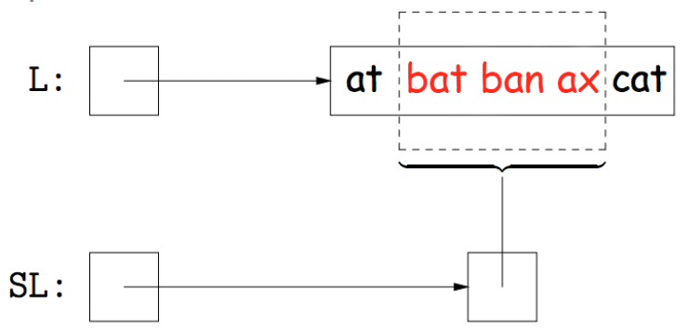
Views into Lists
Allows for general functions
/** Reverses a List */
void reverse(List<String> l) {...}
/** Reverse the sublist no cases */
reverse(SL);
Changes actual list not copy!
Notes:
Why is this useful? Well the first consequence is that it lends to succinct implementations
Consider that you want a method that allows you to reverse an arbitrary portion of any list
You could implement this by taking in as arguments: the list, and two indices
Then you swap everything between the indices
But you could also just take in a list type and reverse the entire list
Then when you want to swap between two indices, just pass in a sublist
Why is the latter better?
You remove logic required to reverse between two indices (since you just do the entire list)
BECAUSE YOU MUTATE THE UNDERLYING LIST
Any questions?

Slide 29
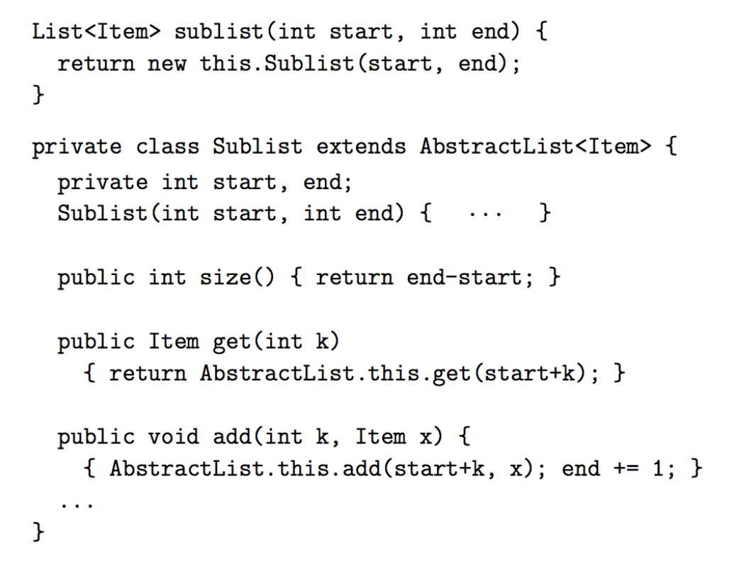
Views into Lists (Implementation)
How do you return an actual List but still have it affect another List?
Access methods!
Code is taken from AbstractList w/ exceptions removed
Returns an actual List type
Only store the range of the view
//exception if start+k >= end
The get/add method uses the surrounding class’s get/add methods but limits access to the constructed range.
Notes:
Okay but there’s an issue right…
The method we just wrote requires a list type. So how do you return a list type such that when its mutated, it also mutates the underlying list type it was taken from?
The trick is to provide specific wrapper methods
Example
This code is actually similar to what’s used in the Java SDK and can be found in the AbstractList class
Things to notice
First notice that subList actually returns a new List type and this type is defined by a class within AbstractList (Sublist)
This class ONLY stores the range of the view (NOTICE NOTHING IS COPIED OVER)
Now getting and adding are augmented based on the stored range
NOTICE SPECIFICALLY THAT IT CALLS THE GET AND ADD METHOD FROM THE ABSTRACTLIST CLASS SO THAT IT CHANGES THE UNDERLYING OBJECT

Slide 30
Views into Maps
The Map interface provides a number of 'Views' into the Map.
Views can also save time and space.
public interface Map<Key, Value> {
...
/* VIEWS */
/** The set of all keys. */
Set<Key> keySet();
/** The multiset of all values. */
Collection<Value> values();
/** The set of all (key, value) pairs. */
Set<Map.Entry<Key,Value>> entrySet();
...
}
Nested interface!
Notes:
Views also have efficiency consequences too!
So another place that they’re used is in the Map interface. We have
keySet which returns a set object of all (unique) keys
Values which returns a multi-set of all values (so not necessarily unique)
And then entrySet() returns a set of all key, value tuples defined in the nested interface Map.Entry
Now the efficiency consequences follow directly from the fact that we mutate the underlying Map directly
Suppose the map holds a bajillion a gagillion a gulgate key value pairs?
If I want to grab the keySet: w/o a view I would need to maybe construct one held by the Map which will take time and memory!
But with views, I receive immediately limited access into the underlying Map object

Slide 31
Implementation Specific Views
Occasionally, implementation details may allow for views that are too difficult to implement for an abstract type.
Example:
The Map has a keySet() method. Iteration on the keySet() may show keys in any order.
The TreeMap class has a navigableKeySet() method. Iteration on the navigableKeySet() gives keys in order.
Inefficient with a HashMap, so HashMap does not have this method.
Notes:
But one should be careful with implementing views because sometimes they’re too difficult to maintain!
The keySet method in Map allows one to iterate through the keys in any arbitrary order
But suppose we wanted a fixed and consistent way of iterating through keys:
This is only possible in an implementation of the Map interface known as TreeMap (navigableKeySet() will return a set whose iteration will be consistent each time its called).
However, for other implementations of Map (like HashMap whatever that is) we can’t guarantee a consistent order efficiently, thus its just not coded into the view at all!
ANY QUESTIONS?

Slide 32
The Punchline
APIs are hard to design.
Proper design pays massive dividends.
Strive always for code clarity.
Inheritance is a powerful but dangerous tool.
For the next few weeks: Common high performance implementation some of the most common ADTs. Analysis of those implementations.
Lists
Sets
Maps
PriorityQueues
DisjointSets
Notes:
Cool let’s wrap up:
So in this lecture we saw a lot of more advanced OOP design patterns
What are the big picture takeways?
First: a clean design really goes a long way. This is because it makes your code robust (like dominoes pizza sauce) and very VERY maintainable
FUTURE GENERATIONS MAY LOOK UPON YOUR CODE AND BE LIKE WOW THIS PERSON REALLY KNEW THEIR JAVA
Second: Always strive for code clarity. Because at the end of the day (and this is especially true in a workplace setting) someone else will have to read your code. Make their day a little nicer by writing readable and well documented code!
Third: The proper design pattern is a very powerful tool: we have extension, delegation, adapters and views and they can all lead to very succinct and elegant code. But if we use them poorly then we get something like Stacks and lawsuits
With great power comes a box of chocolates.
Congratulations! We’ve now pretty much wrapped up all our content regarding Java. You can now use Java as a tool to study more complex topics such as algorithms and datastructures!
In fact, we recently introduced ADTs, well one of the upcoming themes is that we’re going to teach you not only how to implement these ADTs but to do so with STYLE
Your code will not only be slick, but it will hopefully run slick as well. So be slick my friends
Any last questions?

Slide 33
Citations
Title images:
Ballpoint pen diagram: https://qph.is.quoracdn.net/main-qimg-ab1f27c758b4c3074800cc0284c93230?convert_to_webp=true
Dude from ICP: http://goo.gl/gZZwq9

